Slide 1
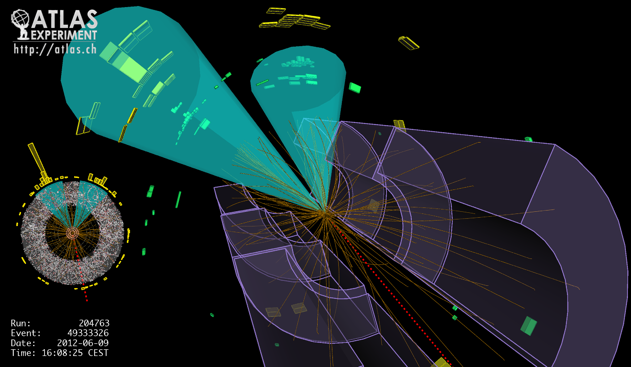
Lecture #4
Prof. Dr. Florencia Canelli
Universität Zürich
Elementary particle physics - PHY451
HS2016
Credits: CERN Summer lectures (di Lella), Hadron collider lectures

Slide 2
The quark model
Late 1950’s – early 1960’s: discovery of many strongly interacting particles
at the high energy proton accelerators (Berkeley Bevatron, BNL AGS, CERN PS),
all with very short mean life times (10^{–20} – 10^{–23} s, typical of strong decays)
⇒ catalog of > 100 strongly interacting particles (collectively named “hadrons”)
ARE HADRONS ELEMENTARY PARTICLES?
1964 (Gell-Mann, Zweig): Hadron classification into “families”;
observation that all hadrons could be built from three spin ½
“building blocks” (named “quarks” by Gell-Mann):
u d s
Electric charge
( units |e| )
Baryonic number
Strangeness
+2/3 −1/3 −1/3
1/3 1/3 1/3
0 0 −1
and three antiquarks ( u , d , s ) with opposite electric charge
and opposite baryonic number and strangeness

Slide 3
Building hadrons
Mesons: quark – antiquark pairs
Examples of non-strange mesons:
Examples of strange mesons:
Baryons: three quarks bound together
Antibaryons: three antiquarks bound together
Examples of non-strange baryons:
Examples of strangeness –1 baryons:
Examples of strangeness –2 baryons:

Slide 4
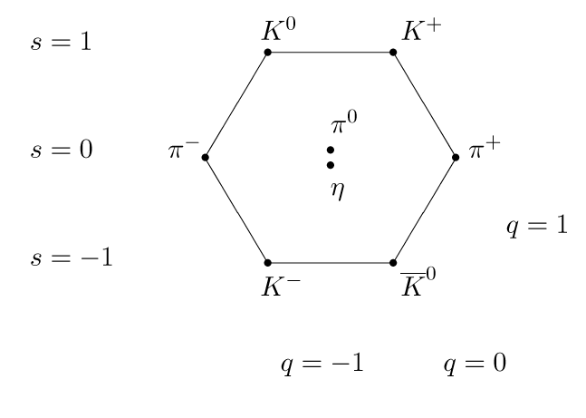
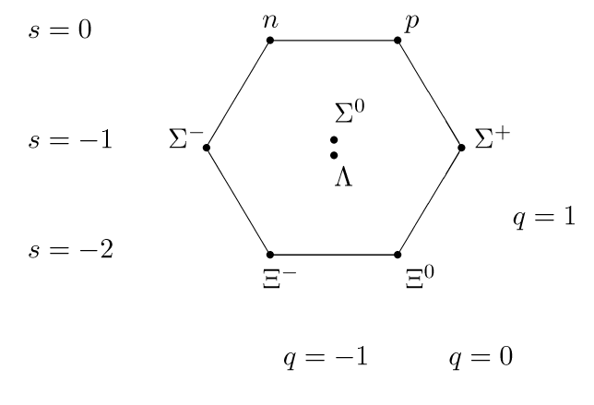
The Eightfold way
Eightfold classification.
Geometrical patterns (hexagons) for particles with identical spin (0 and ½).
Strangeness is along vertical lines, isospin along horizontal lines, charge along diagonals.
Note that there are two neutral states in the middle of each hexagon.
Charge
Strangeness
Isospin third component

Slide 5
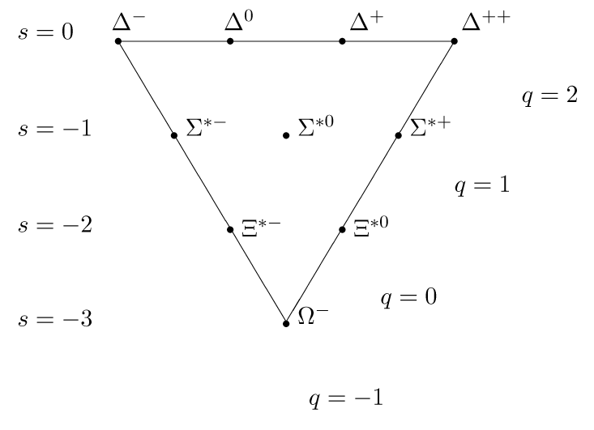
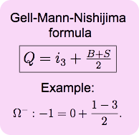


The Eightfold way
Eightfold way named after the eight states (octet) organized in the hexagons.
But not only hexagons, also larger triangles (spin 3/2), ten states => decuplet
In 1961, tip was missing (Omega-). Gell-Mann’s prediction: m = 1672 MeV, plus production and (long) lifetime
Talk by Gell-Mann
Feymann/Gell-Mann

Slide 6
Prediction and discovery of the Ω– particle
A success of the static quark model
3
2
The “decuplet” of spin baryons
Strangeness Mass (MeV/c ² )
0 N*⁺⁺ N*⁺ N*° N*– 1232
uuu uud udd ddd
–1 Σ*⁺ Σ*° Σ*– 1384
suu sud sdd
–2 Ξ*° Ξ*– 1533
ssu ssd
–3 Ω– 1672 (predicted)
sss
Ω–: the bound state of three s – quarks with the lowest mass
with total angular momentum = 3/ 2 ⇒
Pauli’s exclusion principle requires that the three quarks
cannot be identical

Slide 7
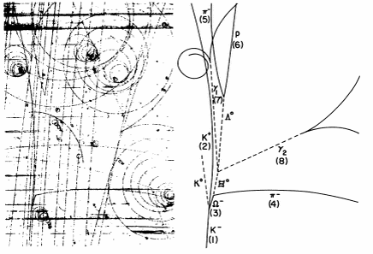
The Eightfold way
Finding the Ω- (1964) triumph – of the eightfold way
Chain of events in the picture:
(strangeness conserving)
(ΔS = 1 weak decay)
(ΔS = 1 weak decay)
(ΔS = 1 weak decay)
(electromagnetic decay)
Ω– mass measured from this event = 1686 ± 12 MeV/c²

Slide 8
The Eightfold way
In the following 10 years every new hadron found a place in one of the Eightfold Way supermultiplets.
There are also antibayron octet, decuplet, etc. with opposite charge and strangeness.
Classification is the first stage in the development of any science.
Modern era of in particle physics started here

Slide 9
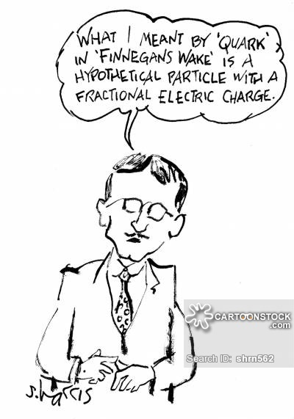
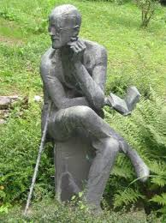
The quark model
Eightfold way extremely successful, but why?
Gell-Mann & Zweig (independent from each other 1964):
All hadrons are composed of even more elementary constituents: quarks
James Joyce tomb @
Zurichberg cemetery

Slide 10
The quark model
Do quarks exist?
If you hit hard enough do the quarks come out ?
At least one of the quarks should be stable ? (nothing lighter to decay to)
Skepticism in late 60’s and early 70’s
Introduced “quark confinement”
James Joyce tomb @
Zurichberg cemetery

Slide 11
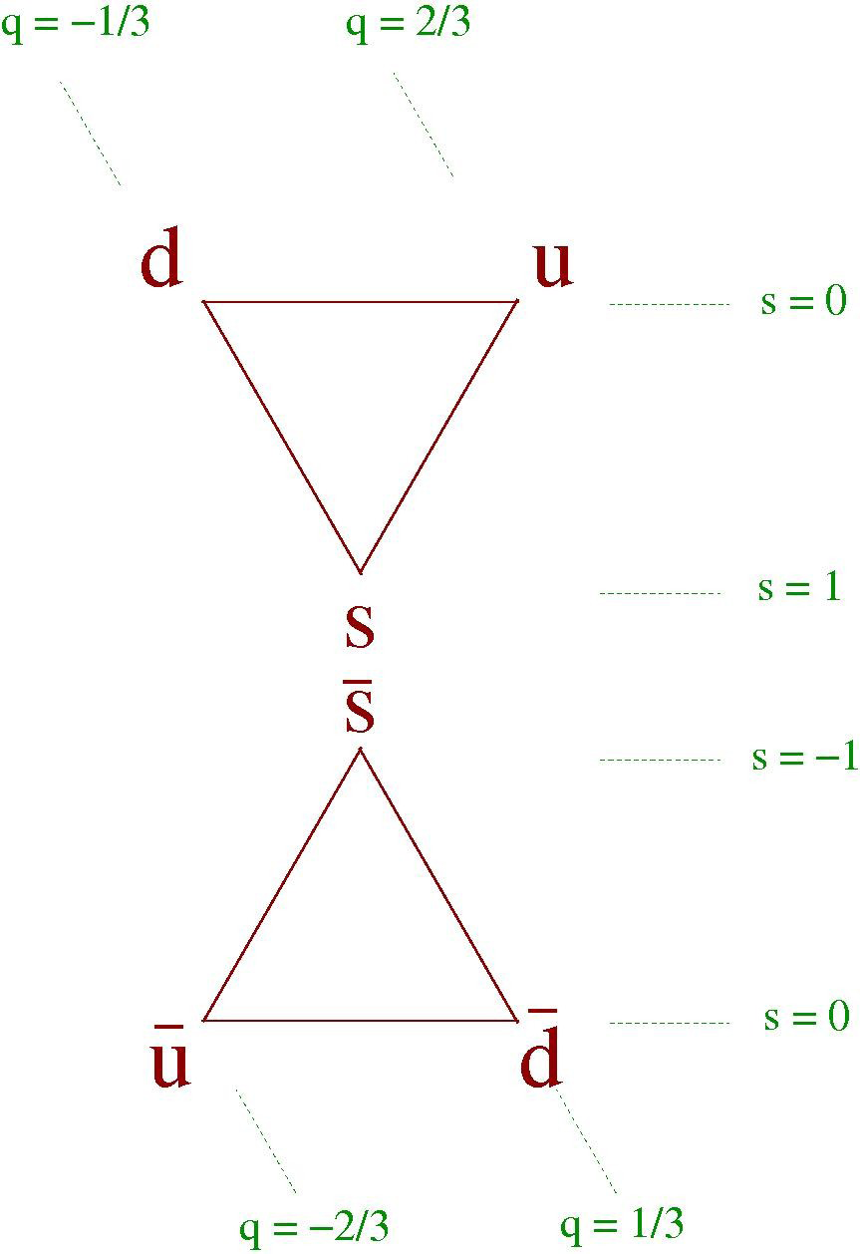
The (light) quark model
Quarks come in 3 flavors, forming a triangular Eightfold Way (now we know that there are 6 flavors of quarks)
Baryons: composed of 3 quarks (or 3 antiquarks)
Mesons: composed of quark and antiquark

Slide 12
Mesons
Earliest example: The pions
Three charges π⁺, π⁰, π⁻ so I = 1

Slide 13
Baryons
Earliest examples: p and n
Fact that both appear to see same nuclear force and that the masses are so close together (m_{p} = 938.20 MeV, m_{n} = 939.57 MeV) make it natural to think of them as 2 states of same particle: the nucleon N
Define isospin (with same algebra as spin: SU(2)). Then N has I = 1/2 :

Slide 14
Building mesons
Fundamental representation: a doublet
If the quarks of the meson are
Antiparallel (singlet state, s=0), the configuration is called pseudoscalar (JP=0-)
Parallel (triplet state, s=1), the configuration is called vector (JP=1-)

Slide 15
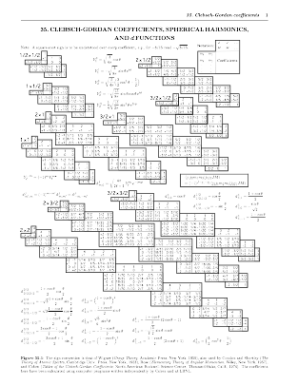
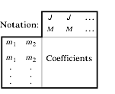
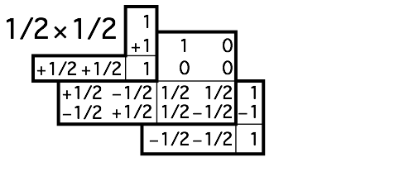
Glebsch-Gordan coefficients
Adding total angular momentum for a system of 2 particles
J angular momentum
M angular projection on z

Slide 16
Two spin ½ states
Combining we get an isotriplet and a singlet
isotriplet
singlet

Slide 17
Pseudoscalar mesons (J^{P}=0-)
Using the representation on page 20.
isotriplet
(there is a sign missing here, but beyond the point we are trying to get at.)
singlet

Slide 18
Pseudoscalar mesons (J^{P}=0-)
Adding a third quark possibility, s
And the missing singlets (carry identical quantum numbers, they mix).
We have combined the three light quarks (belonging to the fundamental representation – denoted 3 for quarks and 3bar for antiquarks) of SU(3) in an octet and a singlet.

Slide 19
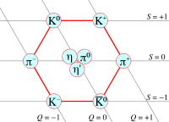
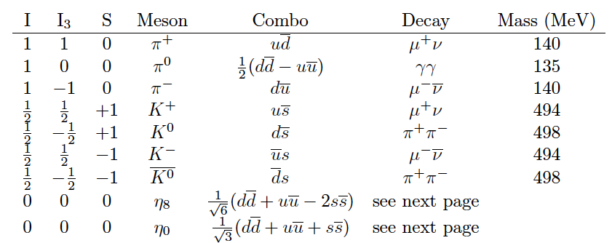
Pseudoscalar mesons (J^{P}=0-)
Table from M. Shapiro, LBNL

Slide 20
Pseudoscalar mesons (J^{P}=0-)
The η₈ and η₀ would be degenerate if SU(3) were perfect symmetry.
These particles carry identical quantum numbers and they tend to mix.
The states can mix. Physical states are:
η : Mass=549 GeV Decay:
η’ : Mass=958 GeV Decays:

Slide 21
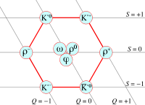
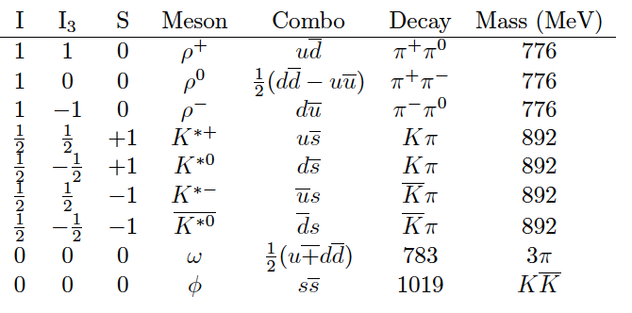
Vector mesons (J^{P}=1⁻)
Table from M. Shapiro, LBNL

Slide 22
Vector mesons (J^{P}=1⁻)
Mixing among ω and ϕ is maximal.
The composition of ϕ is entirely s-quarks.
And ω is u and d-quarks.
Unlike the pseudoscalars which decay weakly, the vectors can decay strongly, eg.

Slide 23
Mass relations
Mass of strange mesons larger than non-strange by 150 MeV
SU(3) not a perfect symmetry
Roughly speaking K weighs more than π’s because it has a s instead of a u or d
But that is not all since the pseudoscalar and vector mesons differ only in the relative orientation of their quark spins
Spins might have an effect on the mass

Slide 24
Mass relations
Can be described in terms of color force between quarks.
More in lectures later.
Hyperfine splitting of the hadron energy levels.
Accounts for pion(140)and rho(776) difference in mass.
Agrees well with observation.
Where A is a constant, contains α
Subscripts represent different quarks

Slide 25
Light baryons
Three quarks in a bound state constitute a fermion.
We must consider Pauli exclusion principle.
Wave function must be antisymmetrical: Ψ(1,2)= -Ψ(2,1)
Ψ(space): we don’t know the functional form but in l=l’=0 it should be symmetrical since there is no angular dependence.

Slide 26
Light baryons - spin
Ψ(spin): Combining 3 quarks in a state of zero orbital momentum (l=0) the baryon can have a spin s =3/2 or s =1/2, so
J^{P}=3/2 produce symmetric states
J^{P}=1/2 produce mixed symmetry states

Slide 27
Light baryons - spin
Spin 3/2(Ψ_{s})
Spin 1/2(Ψ₁₂)
We could also construct
Ψ₁₃ but it would be included as a linear comb. of these two: not independent
Spin 1/2(Ψ₂₃)

Slide 28
Light baryons - flavor
There are 27 possibilities for Ψ(flavor)
3 states
6 states
symmetric
1 states
8 states
mixed
8 states
mixed
1 states
antisymmetric

Slide 29
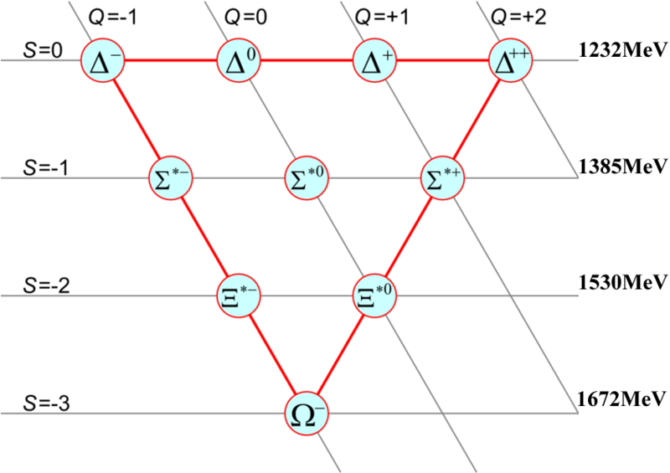
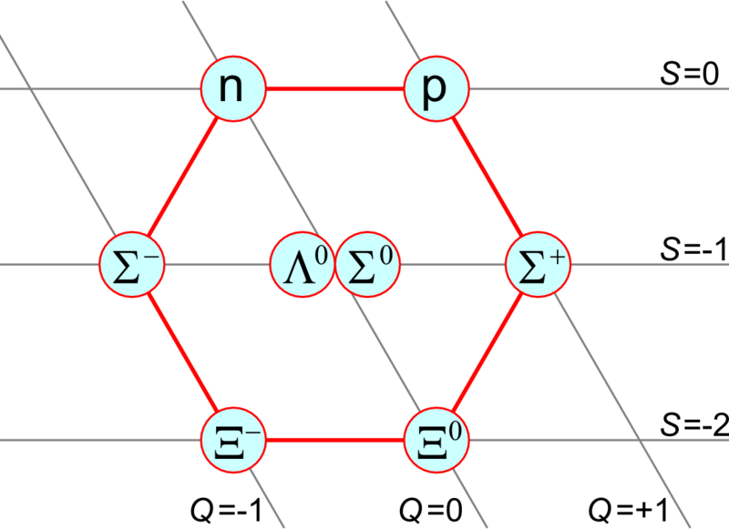
Light baryons - flavor
They yield a decuplet, a singlet, and two octets

Slide 30
Light baryons - color
Impose Fermi statistics on known baryon states
Δ⁺⁺ = uu, spin=3/2, s-wave (l=l’=0): These are all symmetric under interchange of quarks
Need another degree of freedom to antisymmetrize!
must have at least 3 possible states, since we are antisymmetrizing 3 objects
Introduce a new quantum number: color
Colors exist in red, green, blue
Baryons and mesons have zero net color => observable hadrons are color singlets
The color singlet states are anti-symmetric under color exchange
By putting together 3 colors we obtain a color decuplet, 2 octets, and a color singlet
Nature chooses the singlet
This is an asymmetric wave

Slide 31
Light baryons
Since color is anti-symmetric, the rest of the wave function needs to be symmetric
Our rules allow only particles in
the baryon decuplet flavor formed with the symmetric spin state
the baryon octet flavor formed with the mixed symmetry spin states and the flavor octets

Slide 32
What do we know today ?
All information about our current knowledge of mesons and baryons is compiled yearly
Explore here: http://pdg.lbl.gov/

